Slide 1
Introduction to DBMS
Day 2

Slide 2
Module Objective
To describe the Data , Information and DBMS.
To understand Data Models , types of Data Models, advantages and disadvantages of Data Models.
To compare File System and Database Management System
To explain Database System, Application and Server Architecture.
To explain the applications of Database Management Systems.
To understand the roles of different users in DBMS

Slide 3
General Guideline
© (2021) ABES Engineering College.
This document contains valuable confidential and proprietary information of ABESEC. Such confidential and proprietary information includes, amongst others, proprietary intellectual property which can be legally protected and commercialized. Such information is furnished herein for training purposes only. Except with the express prior written permission of ABESEC, this document and the information contained herein may not be published, disclosed, or used for any other purpose.

Slide 4
Topics Covered
Day 1
Data and Information
Day 2
Data Models
Day 3
Database System Architecture
Database Application Architecture
Day 4
Database Server Architecture
Applications of DBMS
Types of Data Models
Introduction to DBMS
Database Users
File System Vs DBMS
History of DBMS
Data Independence and its types.
Phases of Database Design.

Slide 5
Session Plan - Day 2
Data Models
Importance of Data Models
Types of Data Models
Hierarchical Model
Network Model
Relational Model
Object Oriented Data Model
Object-Relational Model

Slide 6
Data Models
6

Slide 7
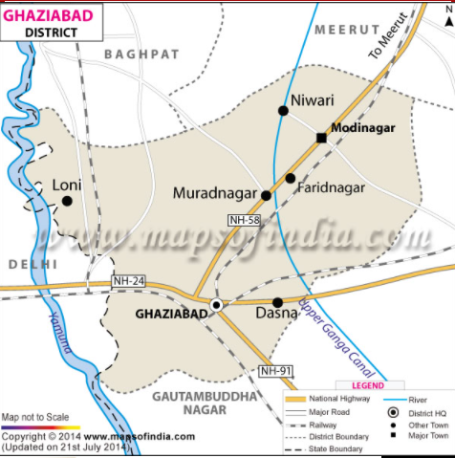
Model
The model represents a perception of reality. For example, a city map represents the model of the city in reality.

Slide 8
Data Models
A data model is a collection of concepts that can be used to represent the structure of a database in a simple way.
It provides a way to describe the design of the database at the physical, logical and view level.
A collection of conceptual tools for describing a data model are:
o Data
o Data relationships
o Data Semantics
o Data constraints

Slide 9
Importance of Data Models
Simple and graphical representation.
Communication tools.
Felicitates Good database design.
It organizes data and hides the complexity.
It improves understanding of the organization

Slide 10
Types of Data Models
Record Based Data Model
Hierarchical Model
Network Model
Relational Model
Object Based Data Model
Object Oriented Model
Object Relational Model

Slide 11
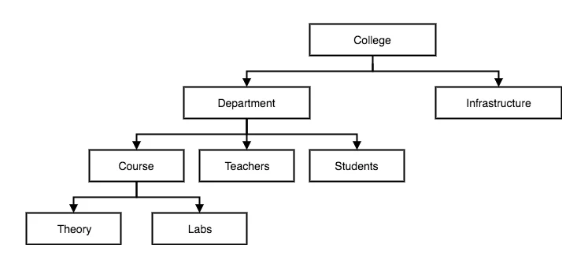
Hierarchical Model
It is a data model in which the data is arranged in a hierarchical tree edifice.
Ex: College Management System

Slide 12
Hierarchical Model Contd.
In this model, data is stored in the form of records which are the collection of fields.
The first node of the tree is called the root node.
When data needs to be retrieved, then the whole tree is traversed starting from the root node.
This model can represent only one-to-many relationships

Slide 13
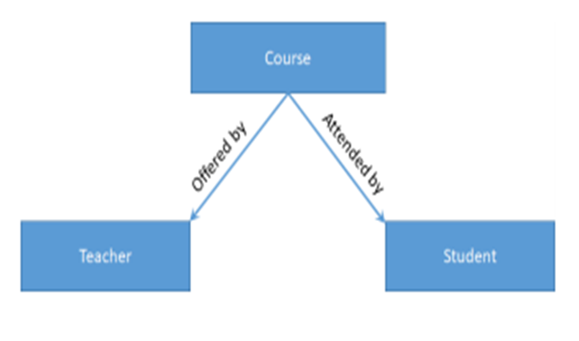
Hierarchical Model Contd.
Queries answered by Hierarchical Model
Who is teaching a particular course?
Who has registered in a particular course?
Queries Not Answered.
What are the courses being offered by a faculty?
What are the courses being attended by a student?
Whom are the students being taught by a faculty?
Whom are the faculty teaching a student?
Example of college students who take different courses.

Slide 14
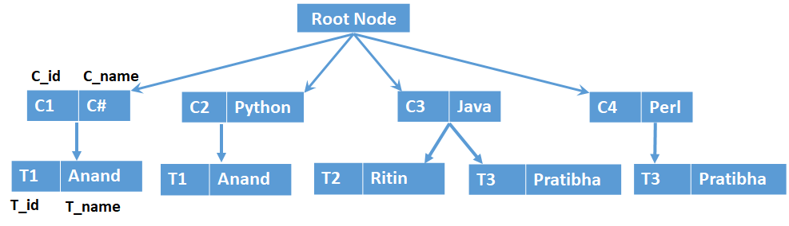
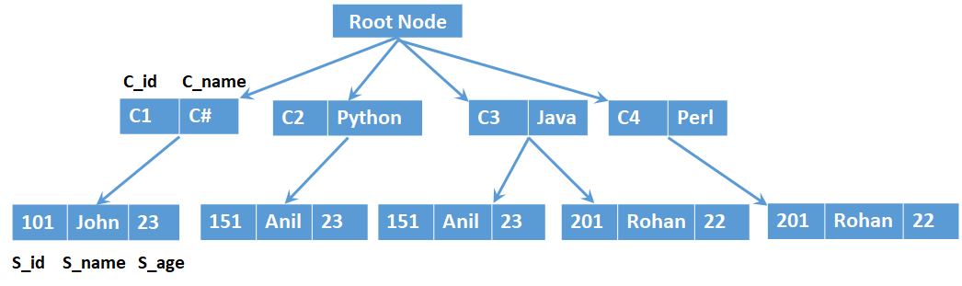
Hierarchical Model Contd.
Example of Hierarchical structure (Course to Student)
Example of Hierarchical structure (Course to Teacher)

Slide 15
Hierarchical Model Contd.
Advantages | Disadvantages
Simplicity | A child record cannot be created if it is not linked to any parent record.
Data Integrity | M: N relationship not supported.
Data Security | Redundancy result in data inconsistency
Efficiency | No DML or DDL.
 | Poor flexibility

Slide 16
Network Model
The network model replaces the hierarchical tree with a graph.
It allows many-to-many relationships.
This model uses a circular linked list to implement the graphs.
A child node in the network model can have more than one parent record.

Slide 17
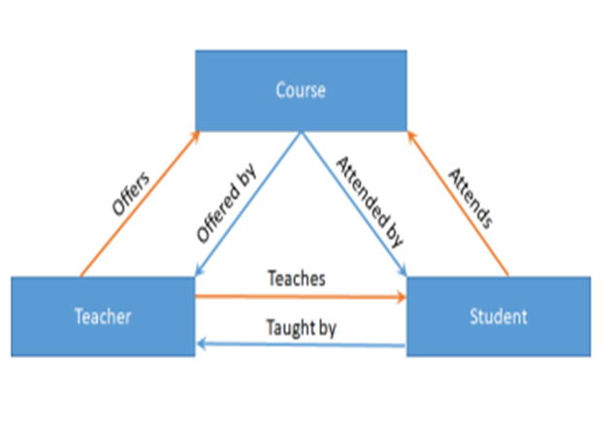
Network Model Contd..
Now the network model can give the answer to all queries mentioned below.
What are the courses being offered by a faculty?
What are the courses being attended by a student?
Whom are the students being taught by a faculty?
Whom are the faculty teaching a student?
Example of College Students
Records: Course, Teacher, Student
Relationship: Offered by, Attended by, Taught by, Offers, Attends, Teaches

Slide 18
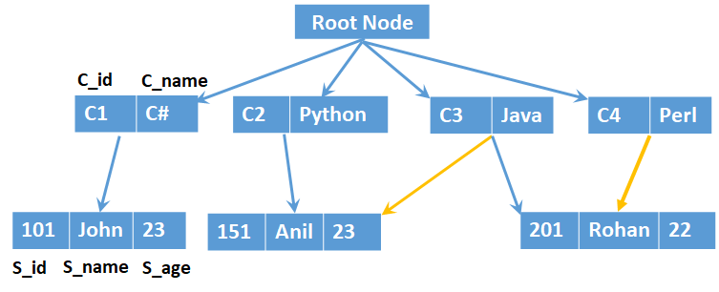
Network Model Contd..
Example of Network structure (Course to Student)

Slide 19
Network Model Contd..
Some of the popular network databases are:
Integrated Data Store (IDS)
IDMS (Integrated Database Management System)
Raima Database Manager
TurboIMAGE
Univac DMS-1100

Slide 20
Network Model Contd..
Advantages | Disadvantages
Conceptual Simplicity | Implementation Complexity.
Capability to handle more relationship types (M:N Relationship) | Absence of structural Independence
Ease of data access | Any change like updation, deletion, insertion is very complex.
Data Integrity (user must define the owner record before defining the member record.)

Slide 21
Relational Model
This model was introduced in 1970 by E. F. Codd (of IBM).
The relational model foundation is a mathematical concept known as a relation.
A relation is also called a table, as a matrix composed of intersecting rows and columns.
These tables represent both data and relationships amongst the data.
Each row in a relation is called a tuple and represents an instance of that entity.
Each column represents an attribute.
The relational data model is implemented through relational database management system (RDBMS).

Slide 22
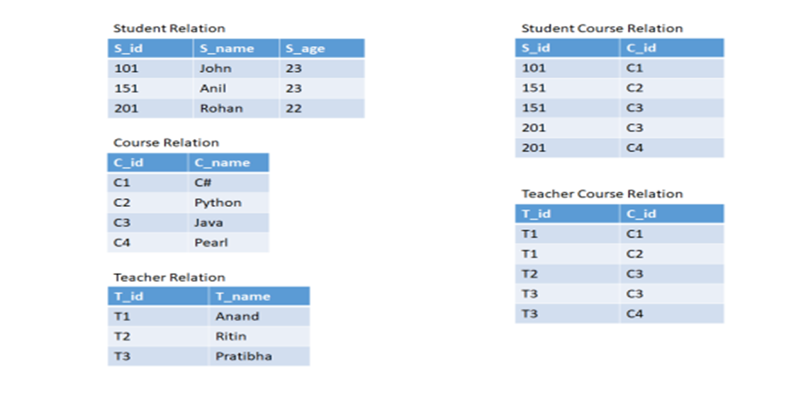
Relational Model

Slide 23
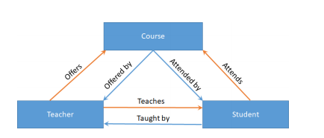
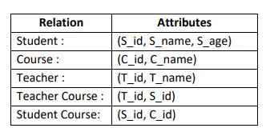
Relational Model Contd.
A relational model corresponding to the network model of records Course, Teacher and Student.

Slide 24
Relational Model Contd.
Advantages | Disadvantages
Structural independence. | Requires hardware and system software overhead.
Tabular view improves conceptual simplicity. | Promote information problems, As relational data model is easy to use, thus many departments may create their own database application, which creates the problem in integrating information and may create the issues of data inconsistency, redundancy, duplication, etc.
Ad hoc query capability based on SQL. which permits the user to specify only what needs to be done without specifying how it will be done.
Isolates the end-user from physical-level details. | Few relational databases have limits on the length of fields.
Improves implementation and management simplicity
Focus on Logical design

Slide 25








Popular RDBMS’s

Slide 26
Object-Oriented Data Model
Complex real-world problems demonstrated a need for a data model that more closely represented the real world.
Object oriented models represents an entity as a class and its instance as an object.
A class represents both attributes and the behavior of an entity.

Slide 27



Object-Oriented Data Model Contd.
It is represented using Unified Modeling Language (UML) class diagrams.
It is used to represent data and their relationships.
Object-oriented databases works well with object-oriented programming languages such as Delphi, Ruby, Python, JavaScript, Perl, Java, C#, Visual Basic .NET, C++, Objective-C and Smalltalk.

Slide 28
Object-Oriented Data Model Contd.
Advantages | Disadvantages
Capability to handle large number of different data types | Difficult to maintain
Object oriented programming with database technology | Not suited for all applications.
Semantic content is added.
Object oriented features improve productivity

Slide 29

Object-Relational Data Model
Object Relational Systems combine the advantages of modern object oriented programming languages with relational database features.
Relational database systems are being enhanced by adding an object infrastructure to the database system itself.
Ex: PostgreSQL.

Slide 30
Object-Relational Data Model Contd.
Advantages | Disadvantages
Complex data sets can be saved and retrieved quickly and easily. | Object databases are not widely adopted.
Works well with object-oriented programming languages. | High complexity can cause performance problems.
 | High system overhead slows transactions

Slide 31
Can you answer these questions?
Q No1. What are the three types of data models?
Q No2. What are the disadvantages of data model?
Q No3. What are the advantages of data model?
Q No4. What are the limitations of hierarchical data model?
Q No5. Compare the network data model with hierarchical data model.
Q No6. Compare the network model with the relational model in terms of ease of learning and ease of use?

Slide 32
Summary
Underlying the structure of a database is the data model.
A collection of conceptual tools for describing data, data relationships, data semantics, and data constraints.
The object-oriented data model, for example, extends the representation of entities by adding notions of encapsulation, methods (functions), and object identity.
The object-relational data model combines features of the object-oriented data model and the relational data model.

Slide 33
Thank You

